Slide 1


Introducing Computer Programming into a Projectile Motion Lab
Susa H. Stonedahl¹, Caleb Reiter¹, Forrest Stonedahl²
1-St. Ambrose University, Davenport, IA
2- Augustana College, Rock Island, IL
Association of Physics Teachers-Iowa Annual Section Meeting
November 7, 2015

Slide 2
Computer Programming is important!
Scientists should all understand what computers can do for us.
Computers save time.
Allow us to calculate things we cannot calculate by hand.
I’ve experienced several good students who have wasted many hours doing something simple that could have been done quickly with a computer.

Slide 3
Projectile Motion Lab
Situation:
A projectile is fired from the ground at a specified velocity (magnitude and direction) in an air resistance free world.
Use the computer to:
Calculate the x and y location of its journey at MANY times using kinematics until it returns to the ground.

Slide 4
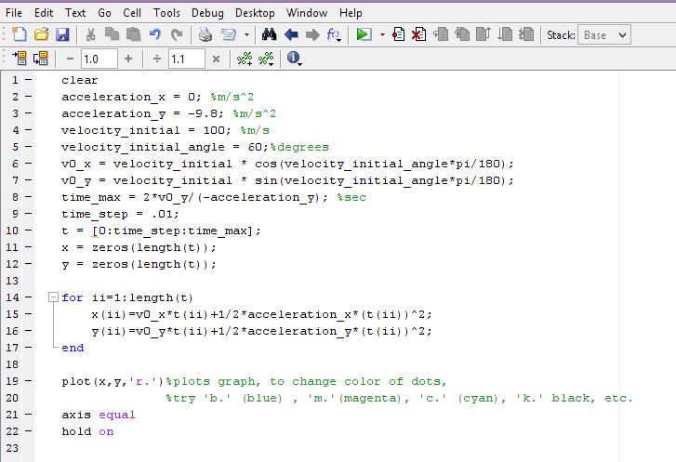

Slide 5
Erase anything already defined

Slide 6
a_{x}=0
a_{y}=-9.8

Slide 7
Set initial velocity:
Magnitude
Direction
They will change these values!

Slide 8
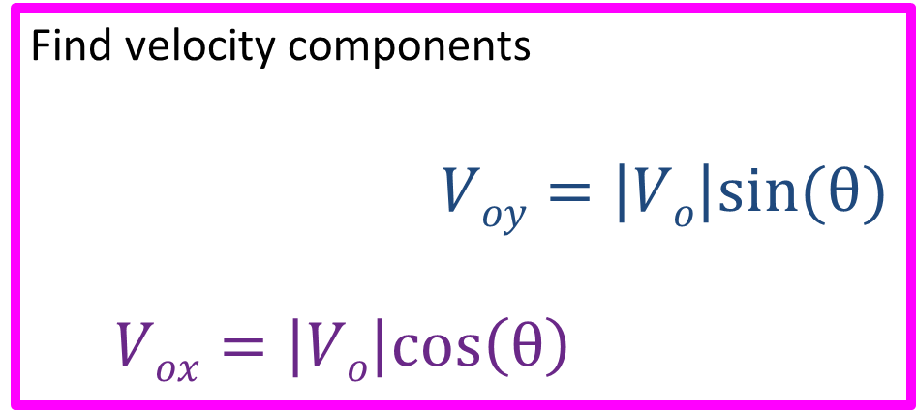

Find velocity components
$Voy=\left|Vo\right|sin(θ)$
$Vox=\left|Vo\right|cos\left(θ\right)$
$$Vo$$
θ

Slide 9
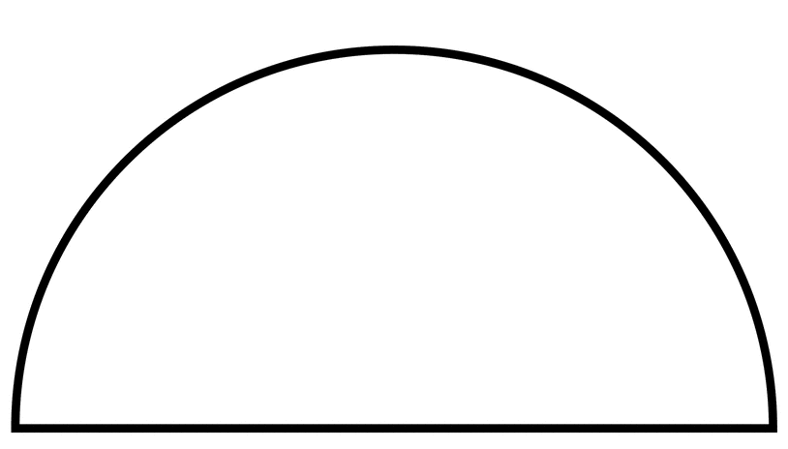
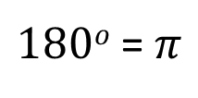
MATLAB works in radians mode, so we have to convert from degrees to radians.
$180o$ =$π$

Slide 10

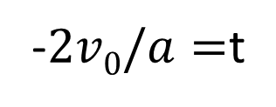
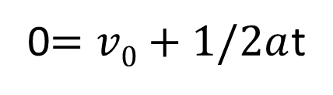
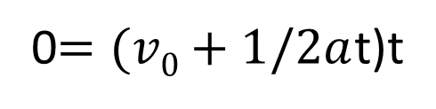
How long until the projectile hits the ground?
d_{y}=0
a_{y}=-9.8
v_{0y}=known
t=goal
$$d=v0t+1/2at2$$
0$=(v0+1/2a$t)t
0$=v0+1/2a$t
-$2v0/a=$t

Slide 11
Let’s calculate everything every 100th of a second

Slide 12
Define all the times:
0, 0.01, 0.02, 0.03, 0.04….time_max

Slide 13
Make lists of x’s and y’s each with the same number of slots as t.

Slide 14

For Loop:
The index ii varies from 1 to the number of time values
$$d=v0t+1/2at2$$

Slide 15
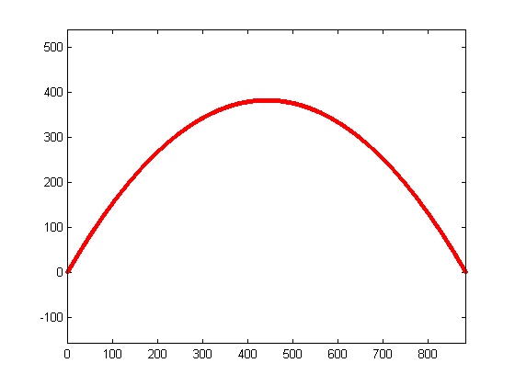

Slide 16
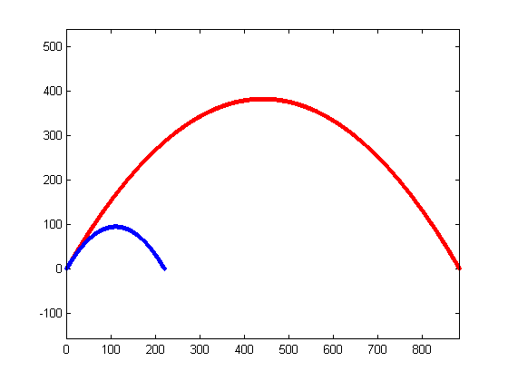
Students are asked to vary the initial velocity’s magnitude:
Vo=100
Vo=50

Slide 17
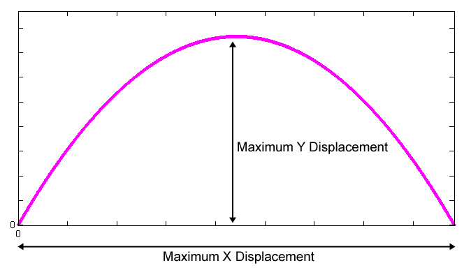
And use kinematics to solve for both displacements!
Students then read the maximum displacements from the graph

Slide 18
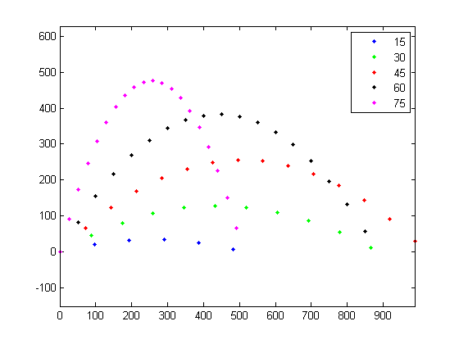
Students then change time_step to 1 second
And use 5 different initial angles:

Slide 19
Counting the dots approximates the time. (Number of dots is the rounded down value of the time.)
And use kinematics to find the times!

Slide 20
I’ve shown you the MATLAB program for this exercise.
My co-authors converted my code into Python, which is a very similar language.
(Python is freely available for download)
The MATLAB code, Python code, and lab exercise are available for download at:
http://susa.stonedahl.com/teaching.html#proj_motion_comp_lab

Slide 21
I’ve shown you the MATLAB program for this exercise.
My co-authors converted my code into Python, which is a very similar language.
(Python is freely available for download)
The MATLAB code, Python code, and lab exercise are available for download at:
http://susa.stonedahl.com/teaching.html#proj_motion_comp_lab
Questions?

